Slide 1
Nuclear Medicine
Radiopharmaceutical chemistry

Slide 2
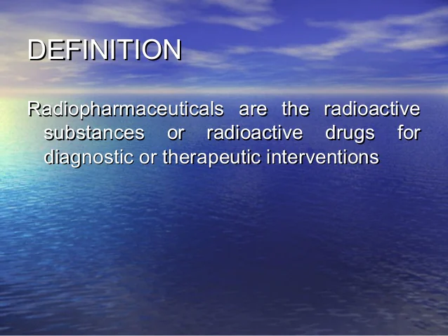

Slide 3
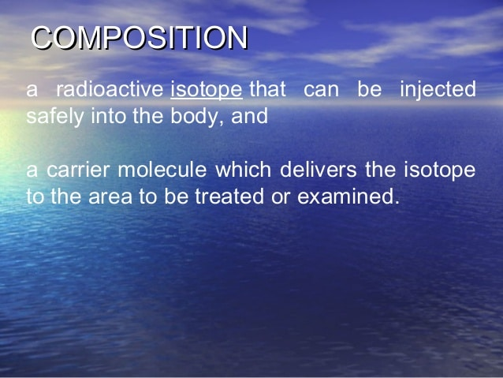

Slide 4
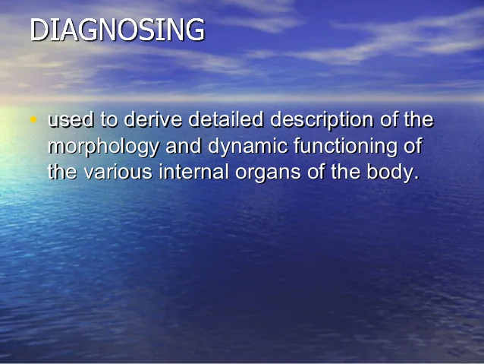

Slide 5
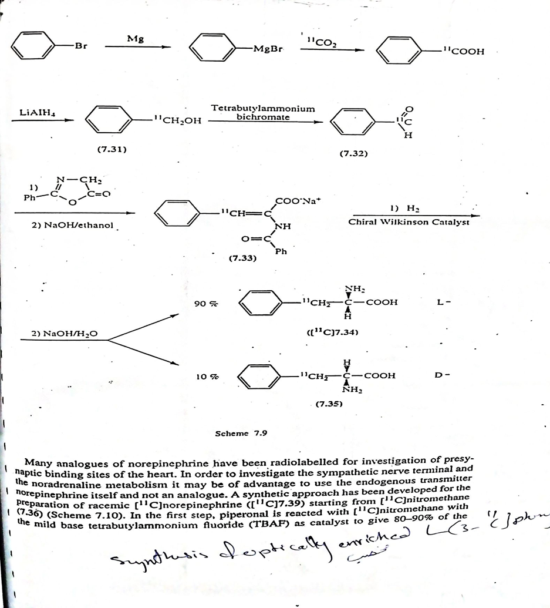

Slide 6
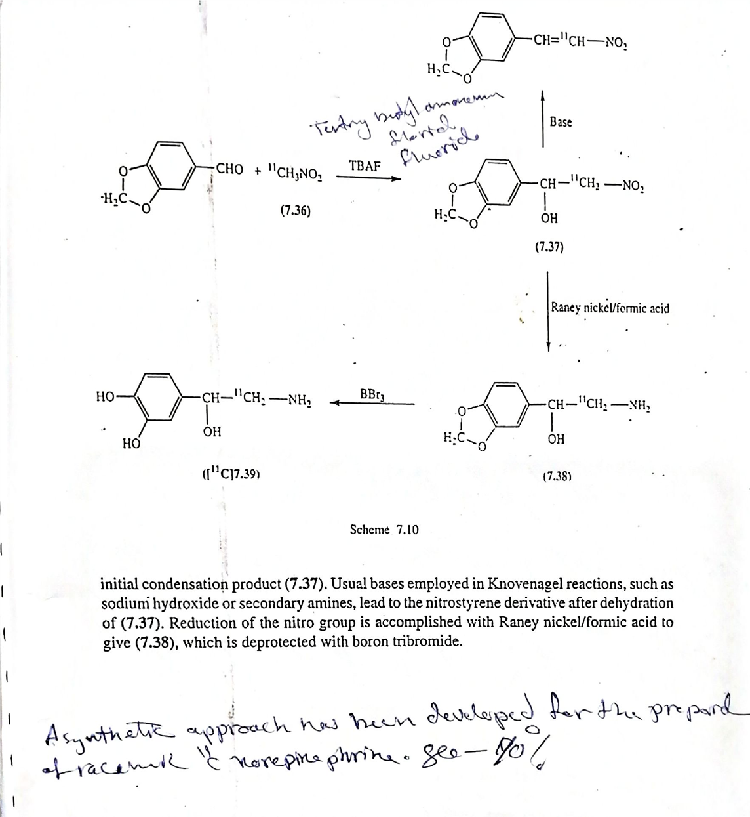

Slide 7
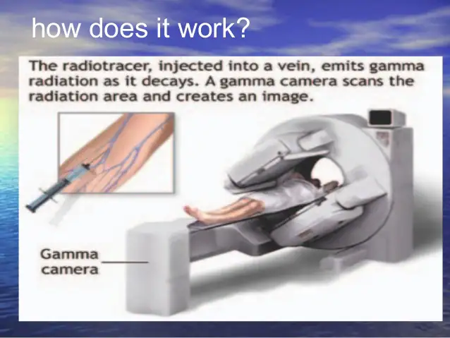

Slide 8
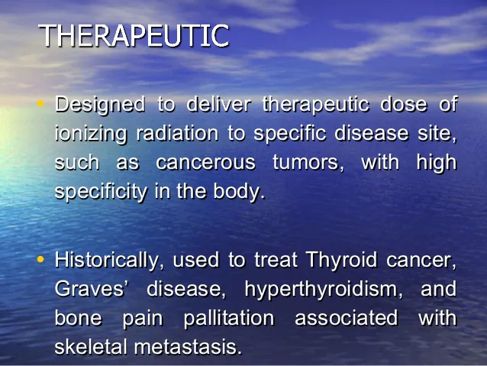

Slide 9
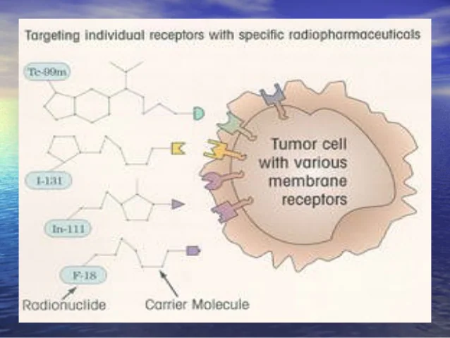

Slide 10


Slide 11


Slide 12
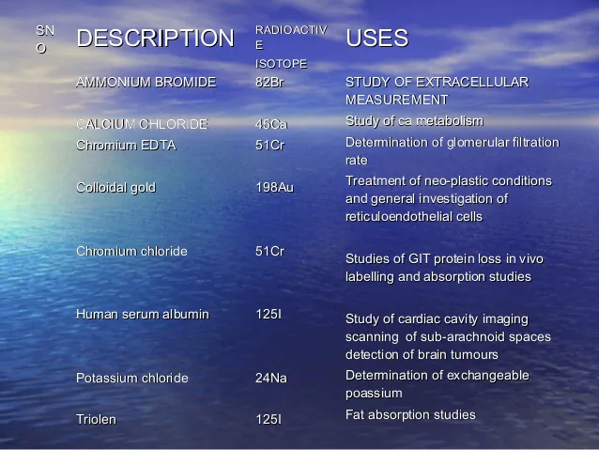

Slide 13
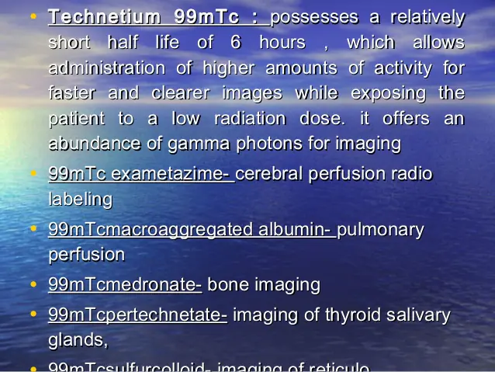

Slide 14
Radiopharmaceutical Preparations
Sodium chromate Cr-51 inj.Na2CrO4(Rachromate)
diagnostically to determine RBC mass ,volume ,& Survival time also scanning the spleen.
Radio-Chromated Serum Albumin Cr-51.
determined plasma volume.

Slide 15
Mechanism of Action
Cr51 is indicated for use in determining red blood cell volume or mass, studying red blood cell survival time (in conditions such as hemolytic anemia), and evaluating blood loss
The chromium in this agent is present as the dianionic chromate ion in which form it appears to bind to the red blood cell in two steps, initially by a rapid but reversible attachment to the cell membrane followed by a slower nearly irreversible binding to intracellular hemoglobin and reduction to the anionic state. It has been suggested that the slow rate of uptake is dependent on the rate at which chromate can penetrate the cell membrane. Binding is maintained until the red blood cells are sequestered by the spleen or until elution of the chromium occurs into the plasma. The chromium is then readily excreted mainly in the urine. Once liberated by elution or erythrocyte senescence, chromium 51 is not available for relabeling of red cells
In normal individuals the erythrocyte survival half-time T ½ as measured by the chromium 51 "random labeling" technique, generally ranges between 25 and 35 days. This apparent short survival time, when compared to the 120 day life span of the red blood cells, is due to the elution of chromium from the cells and to cell damage that probably occurs during the process of withdrawing them from the body and labeling. Subnormal T ½ may be indicative of blood toss, sequestration of red blood cells by the spleen, or shortened cell viability, as occurs In hemolytic anemia

Slide 16
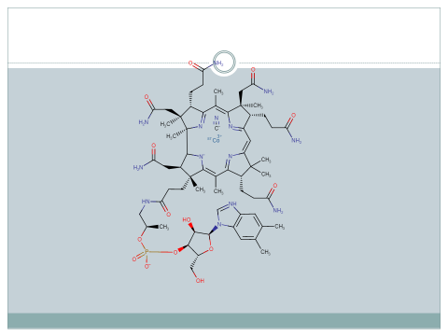
Cyanocobalamin Co-57 ,Co-50,Co-60
-diagnostic procedure for pernicious anemia.
-interstitial implantation.

Slide 17
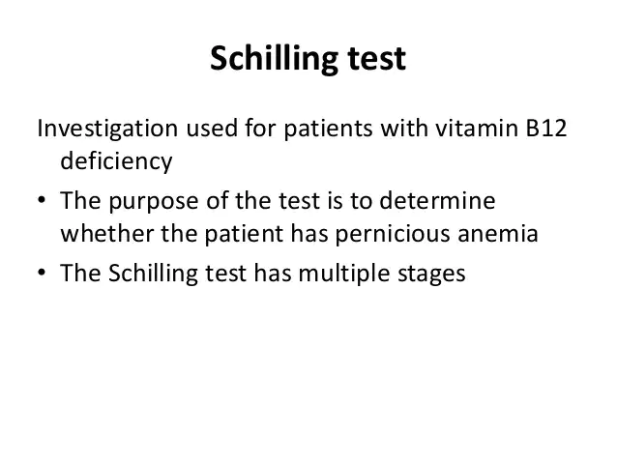
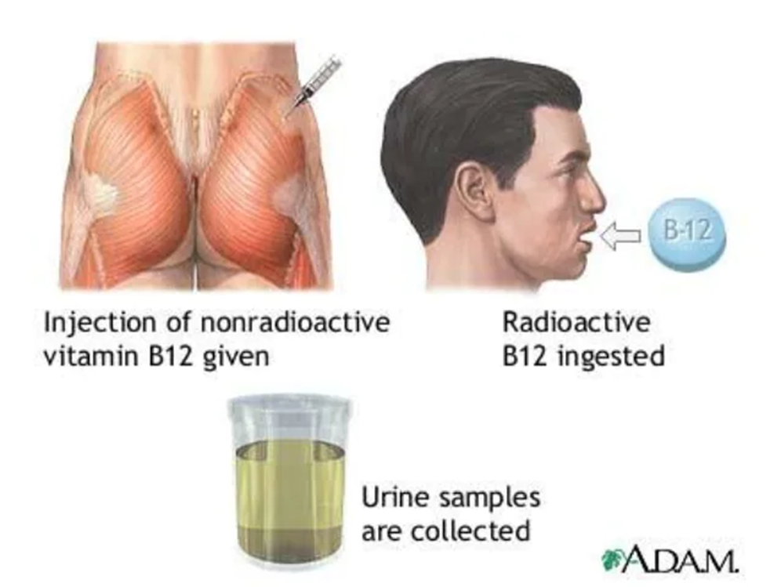

Slide 18
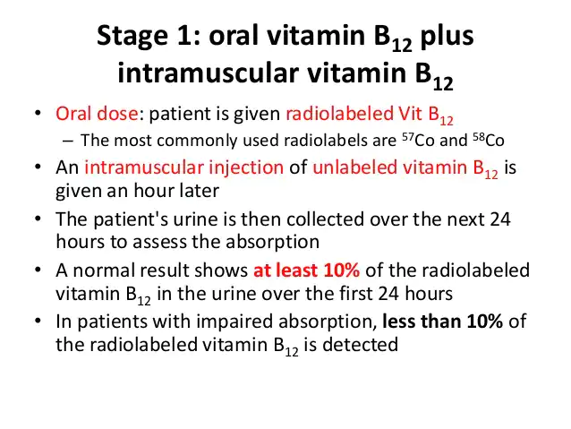

Slide 19
Ferrous citrate and Ferric chloride Fe-59
Diagnostic procedure of iron metabolism and RBC formation
Gold(Aurcoloid-198)
-Solution is categorized as both diagnostic preparation for scintillation scanning of the liver,and a therapeutic preparation in the treatment of disorders secondary to neoplastic diseases.

Slide 20
Iodides I-123, I-125 ,I-131
Sodium iodide
Diagnostic and therapeutic purpose.
Uptake or general thyroid scanning
Scanning for metastatic thyroid cancer.
Therapeutic in the hyperthyroidism cancer. Iodinated Serum Albumin iv
Determination blood and plasma volume and determination cardiac output.

Slide 21
Sodium Iodohippurate inj.
-Diagnostic agent for determine renal function.
Sodium Rose bengal (Robengatope)
-Liver function ,scan size and location
-blood and bile clearance
Mercury -197 and 203
-Chromerodrin Hg inj.
-scanning both kideny and brain

Slide 22
Sodium phosphate P-32
-Used for both diagnosis and treatment of various neoplastic disease .
Technetium 99m

Slide 23
The end
Thank you

